Slide 1
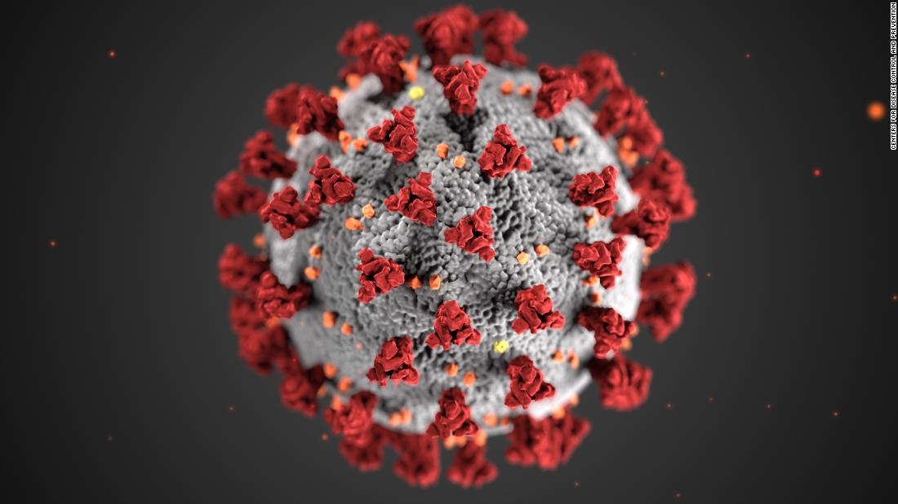
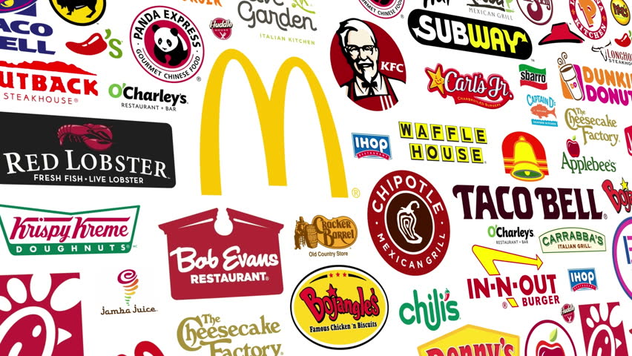
How the Coronavirus
Has Affected the
Fast Food Industry
June 18th, 2020
Sam Gregoryk
Jeffrey David Anderson
Lingbin Li
Yiran Wang

Slide 2
Table of Contents
Executive Summary…………………………………………………………………………………………………………………….3
Background Research………………………………………………………………………………………………………………….5
Qualitative Research……………………………………………………………………………………………………………………9
Survey Research………………………………………………………………………………………………………………………..14
Hypothesis 1……………………………………………………………………………………………………………………………..15
Hypothesis 2……………………………………………………………………………………………………………………………..16
Hypothesis 3……………………………………………………………………………………………………………………………..17
Hypothesis 4……………………………………………………………………………………………………………………………..18
Hypothesis 5……………………………………………………………………………………………………………………………..19
Results…………………………………………………………………………………………………………………….……………..20
Conclusion……………………………………………………………………………………………………………………………….21
Recommendations………………………………………………………………………………………………………………………22
Appendices……………………………………………………………………………………………………………………………….25

Slide 3
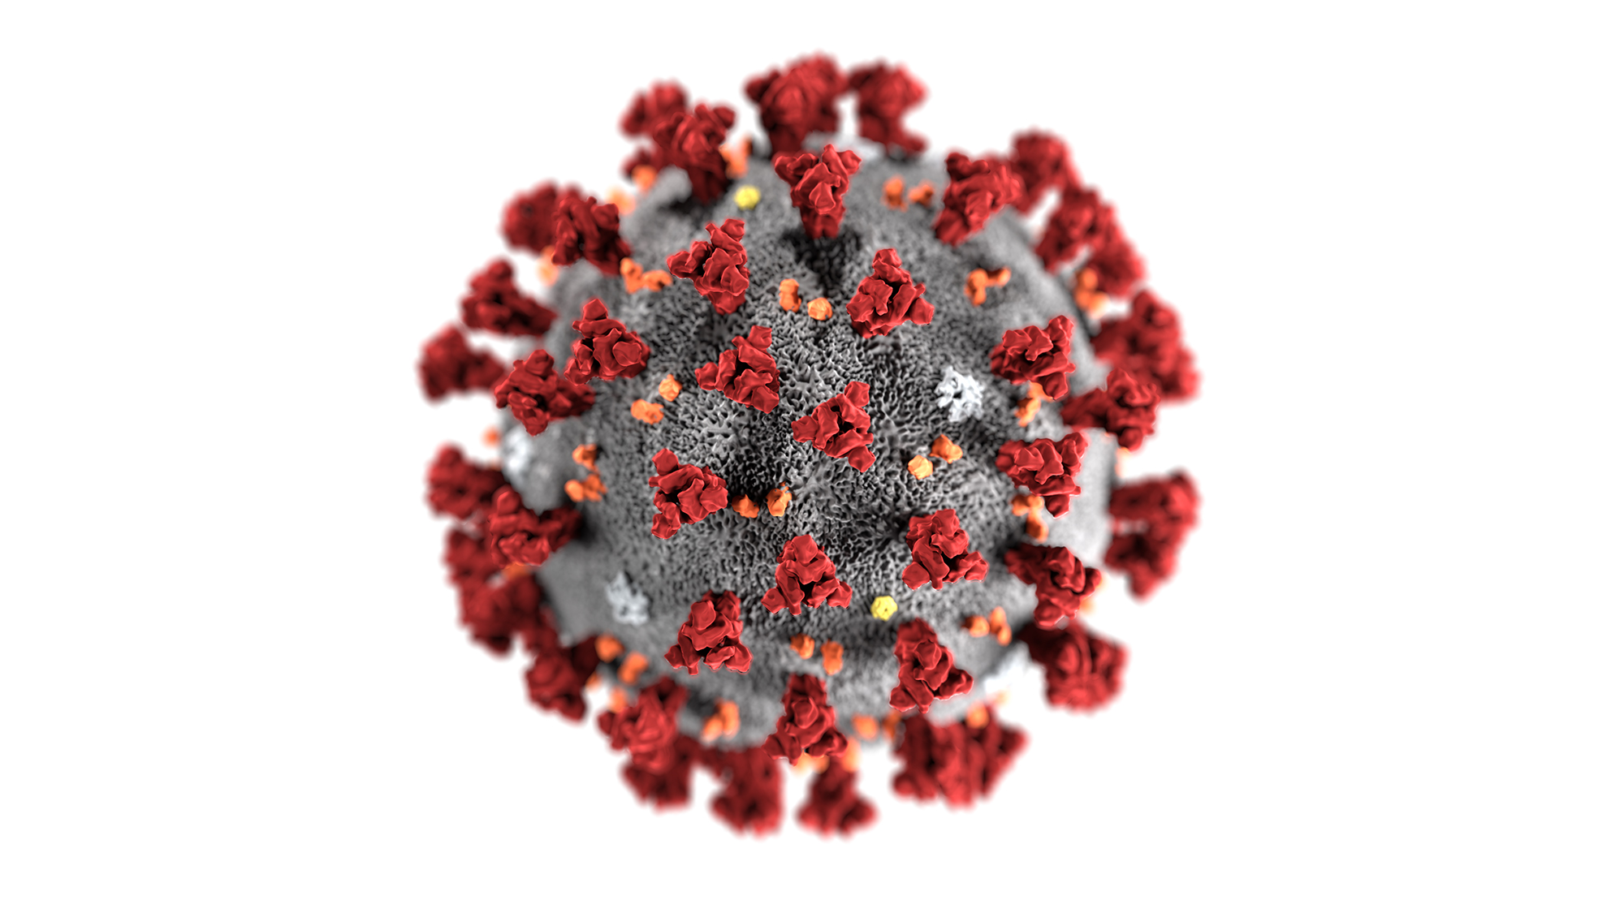
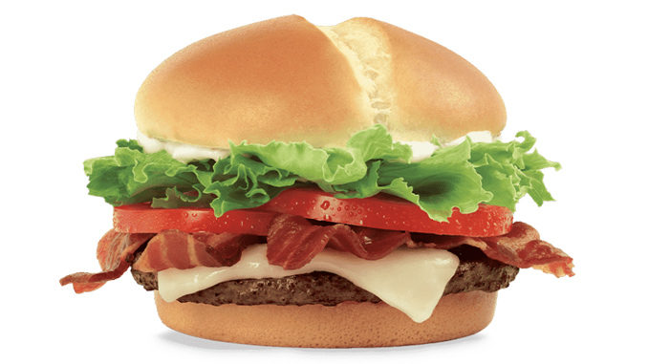

Executive Summary
Overview
Our objective: See how the Coronavirus has affected the fast food industry for people living in Pullman.
Examining attributes such as social distancing regulations, CDC regulations, type of ordering methods, employee productivity and unemployment status.
Methods
Qualtrics Survey with random sampling

Slide 4
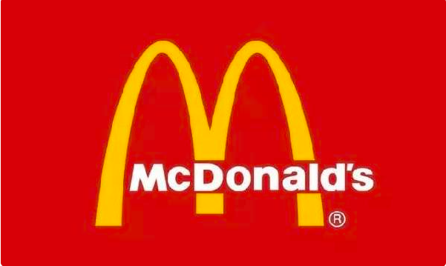
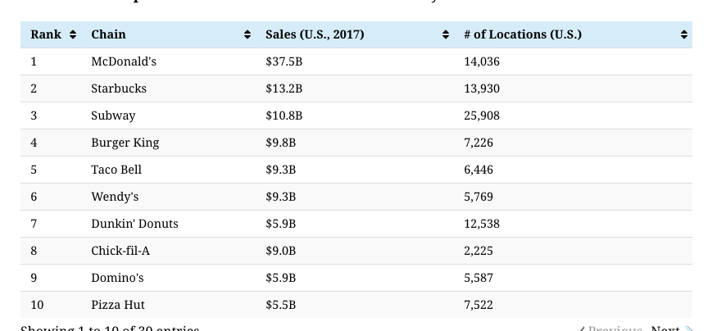
Background Research
Fast food is a part of the American diet and has been associated with (1) high caloric intake, and (2) poor diet quality. Time, financial resources, price, and availability influence fast food consumption.

Slide 5
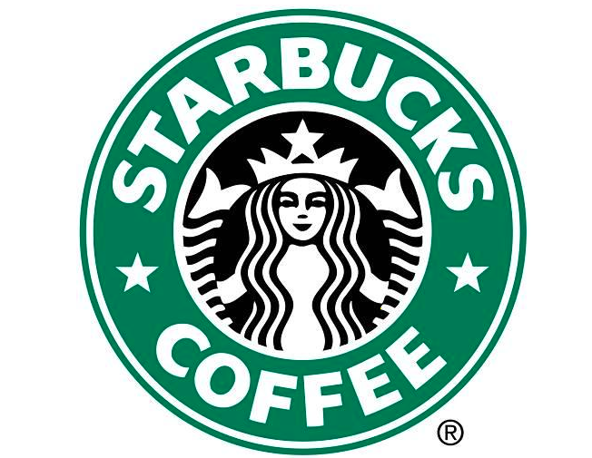
Background Research
The proportion of people ordering food during the period of the COVID-19
The percentage of adults who consumed fast food decreased with age: 44.9% aged 20–39, 37.7% aged 40–59, and 24.1% aged 60 and over.
A higher percentage of non-Hispanic black adults consumed fast food than non-Hispanic white, non-Hispanic Asian, and Hispanic adults.
The percentage of adults who consumed fast food increased with increasing family income.
Among those who consumed fast food, men were more likely than women to eat fast food at lunch, but women were more likely to report eating fast food as a snack.

Slide 6
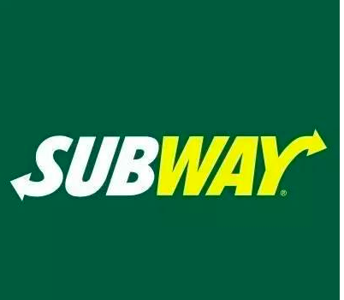
Background Research
20 percent of respondents in Bottle Rocket’s study said they would not return to a quick-service restaurant in the next week
Factors: Becoming better home cooks, fear of virus and tired of eating at same restaurant
More than 33 percent of respondents said they would get at least half of their meals from quick-service restaurants in the next week.
Two camps of people:
Making an effort to be less reliant on takeout and quick-service restaurants.
Continuing to order the majority of my food from quick-service restaurants.”

Slide 7
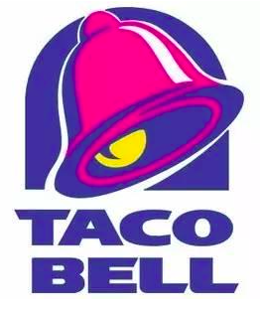
Background Research
In the next seven days, how often do you expect to order from a fast-food restaurant, compared to other restaurants or cooking at home?”
All the time: 8 percent
More than half the time: 11 percent
Half the time: 17 percent
Less than half the time: 47 percent
Not at all: 17 percent

Slide 8
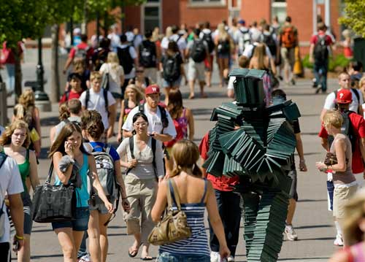
Qualitative Research
The purpose of this survey is to count people's opinions and trust in the fast food industry in the case of COVID-19, and to provide data reference for the improvement and progress of the fast food industry.
Our survey started collecting data on June 4 on Qualtrics. As of June 16, we got a total of 275 responses,but only 110 people finish the whole survey.
The group targeted by our survey is mainly students who live in Pullman, Washington that attended WSU on weekdays.

Slide 9
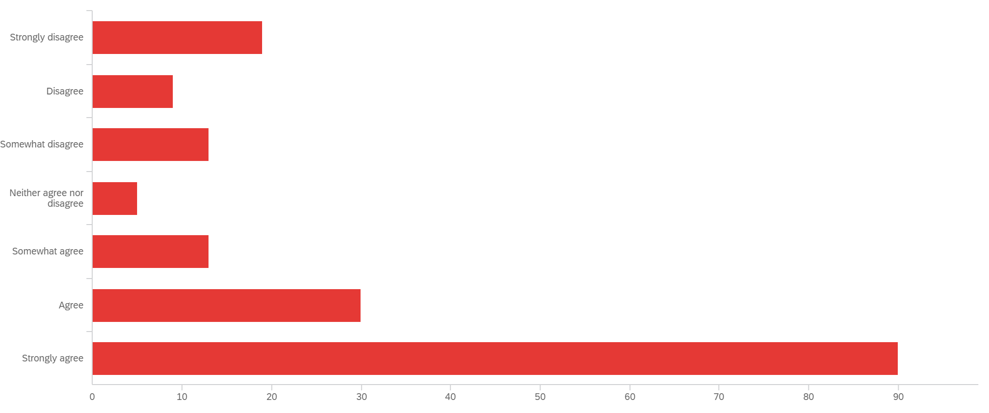
Qualitative Research
Question: To what extent do you agree with the following statements: It is important to social distance in order to stop the spread of Coronavirus?
Notes:
In the “To what extent do you agree with the following statements: It is important to social distance in order to stop the spread of Coronavirus”question, we can see that most people agree on the importance of social distance in preventing the spread of coronavirus in the survey.

Slide 10
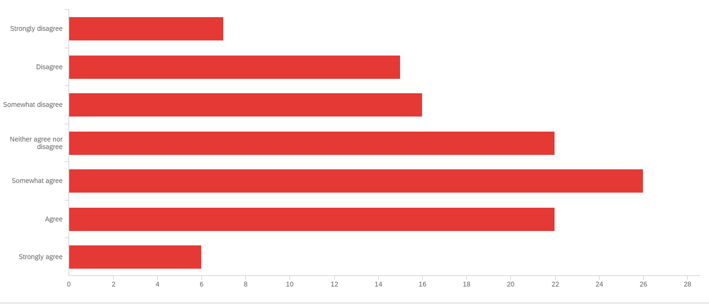
Qualitative Research
Question: I feel secure with how my food is being handled by the employees now.
Notes:
During the “I feel secure with how my food is being handled by the employees now” question, we know that during the COVID-19, the disinfection and cleaning of fast-food restaurants made most of respondents choose “somewhat good” that means feel secure about the food they received than usual.

Slide 11
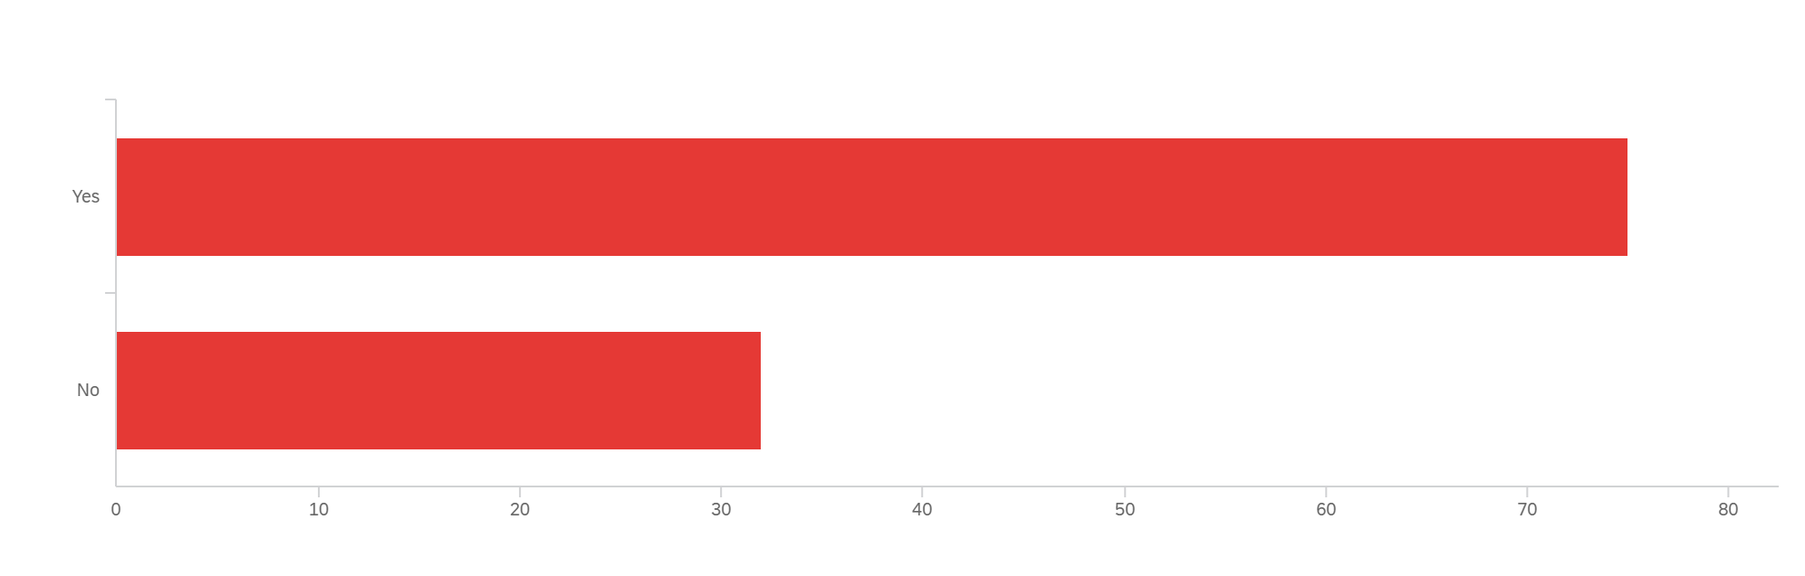
Qualitative Research
“Has Coronavirus impacted your living status?”
Notes:
In the above question, we can see from the data that more people are choosing COVID-19 to impact their lives.
A change in living conditions means a change in the way people deal with it. As a representative type of food industry, fast food should also make some beneficial changes to people's living conditions.

Slide 12
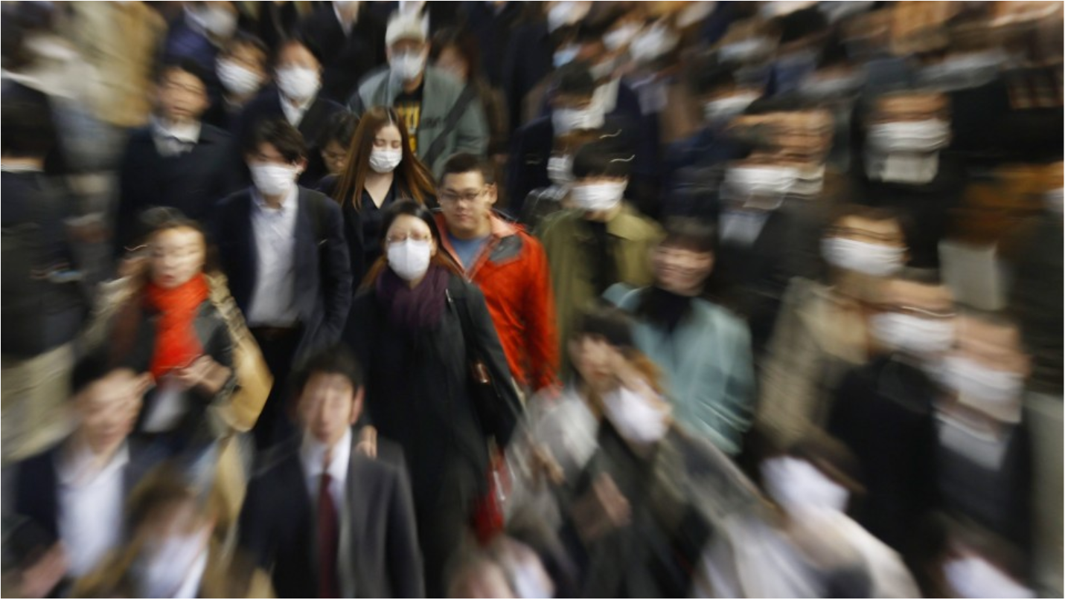
Qualitative Research
In our question above, from the data collected, one noted the importance of social distance to prevent novel Coronavirus and considered it to be of critical importance to the epidemic.
And thanks to the efforts of the fast food industry during the epidemic, people became more comfortable with what they had in their hands. But because of the epidemic, people are still being affected by COVID-19. All aspects of people's lives are affected, not just fast food.
*Disclaimer: The focus group/IDI insights cannot be used to draw conclusions since the information is based on so few participants and may not reflect the views of the research population.

Slide 13

Survey Research
Demographics - Out of the 107 people who completed our survey
Gender:
Males: 36.45%
Females: 45.85%
Prefer not to say: 18.7%
Average Age: 24 years old
Living status:
Pullman: 62.62%
Non-Pullman: 37.38%
Native language:
English 21.5%
Non-English: 78.5%

Slide 14
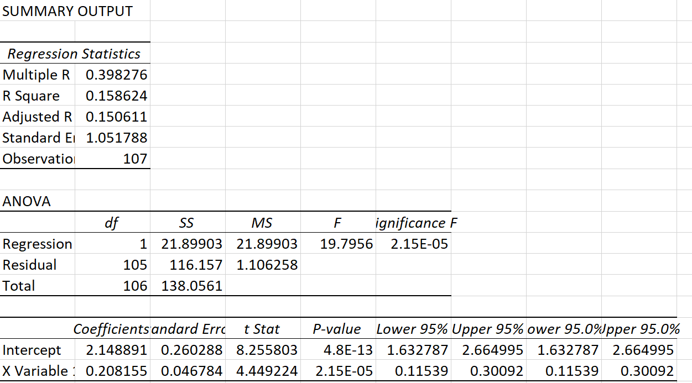
Hypothesis 1
With an increased demand for social distancing regulations, the demand for no contact from the restaurant and the delivery man also increases.
Results:
Y[No Contact] = 0.208 * X[Social Distancing] + 2.15
The correlation between no contact for restaurants and the delivery man and the demand for social distancing is positive.
P value: 4.8E-13 < 0.05
We reject the hypothesis
Notes:
Test: Regression
IV: It is important to social distance in order to stop the spread of Coronavirus.
DV: Have you noticed a change in the amount of PPE (personal protective equipment) that both McDonald's and Uber Eats employees have to wear?

Slide 15
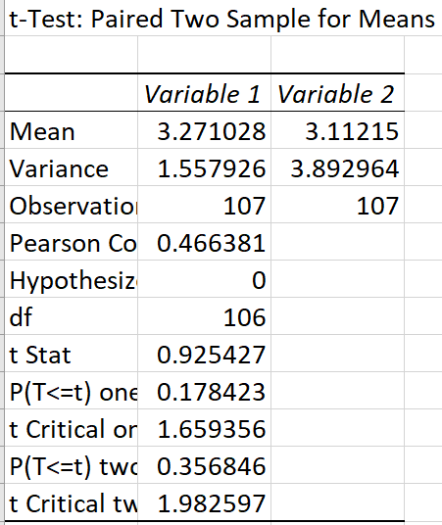
Hypothesis 2
The increased use of delivery will cause a higher rate of delivery after the Coronavirus.
Results:
From the amount of delivery before the Coronavirus (M = 3.27) to the amount of delivery during the Coronavirus (M = 3.11), the amount of delivery did not change significantly.
t(106) = 0.93
P- value: 0.36 > 0.05
We fail to reject the hypothesis

Slide 16
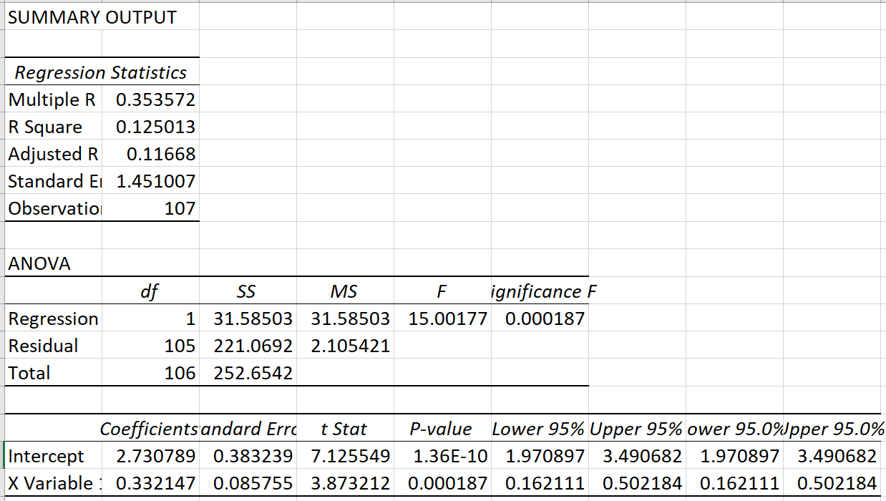
Hypothesis 3
Following the new regulations for the coronavirus will ensure everyone’s safety for both the people making the food and also the people receiving the food.
Results:
Y[CDC Regulations] = 0.33 * X[Safety] + 2.73
The correlation between following CDC regulations and customers and employee safety is positive.
P value: 1.36E-10 < 0.05
We reject the hypothesis

Slide 17
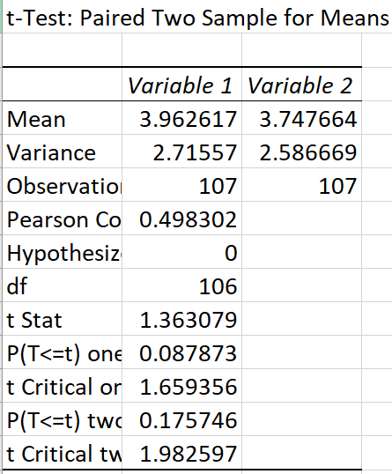
Hypothesis 4
With more people becoming unemployed, the purchase of the value menu at fast food restaurants is more likely.
Results:
From the purchase of value menu before the Coronavirus (M = 3.96) to the purchase of value menu during the Coronavirus (M = 3.75), the the purchase of value menu did not change significantly.
t(106) = 1.36
P-value: 0.18 > 0.05
We fail to reject the hypothesis

Slide 18
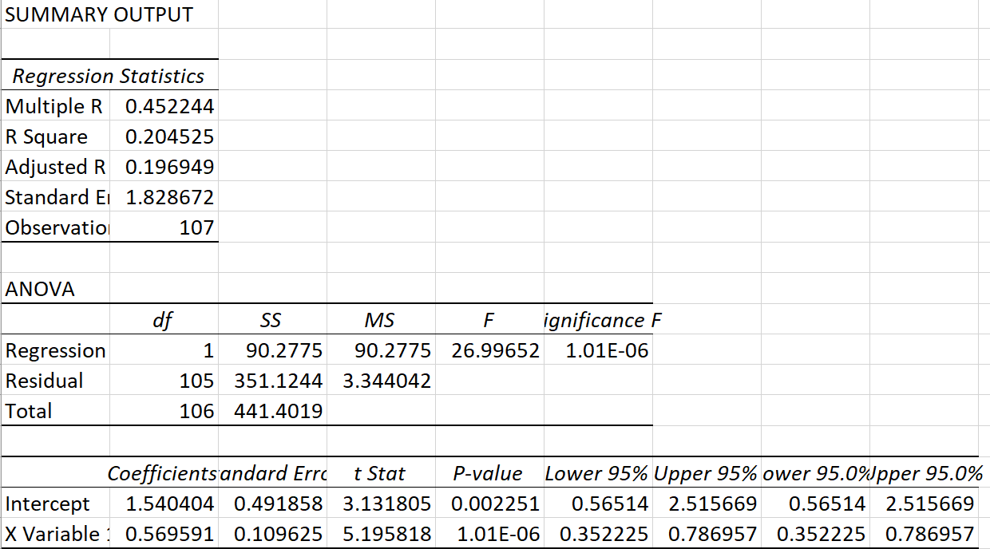
Hypothesis 5
The productivity inside the restaurant will decrease with more customers going through the drive through.
Results:
Y[Productivity] = 0.57 * X[Drive Through] + 1.54
The correlation between productivity and customers going through the drive through is positive.
P value: 0.002 < 0.05
We reject the hypothesis

Slide 19

Results
So how did the Coronavirus affect the fast food industry?
According to our survey respondents…
The increased demand for social distancing did not affect the increase for no contact from restaurants and the delivery man.
The increased use of delivery did cause a higher rate of delivery after the Coronavirus.
Following the new regulations for the coronavirus did not ensure everyone’s safety for both the people making the food and also the people receiving the food.
With more people becoming unemployed, the purchase of the value menu at fast food restaurants is more likely.
The productivity inside the restaurant did not decrease with more customers going through the drive through.

Slide 20
Conclusion
Hypothesis | Supported? | Explanation
With an increased demand for social distancing regulations, the demand for no contact from the restaurant and the delivery man also increases. | No | P-value: 4.8E-13 < 0.05
The increased use of delivery will cause a higher rate of delivery after the Coronavirus. | Yes | P-value: 0.36 > 0.05
Following the new regulations for the coronavirus will ensure everyone’s safety for both the people making the food and also the people receiving the food. | No | P-value: 1.36E-10 < 0.05
With more people becoming unemployed, the purchase of the value menu at fast food restaurants is more likely. | Yes | P-value: 0.18 > 0.05
The productivity inside the restaurant will decrease with more customers going through the drive through. | No | P-value: 0.002 < 0.05

Slide 21

Recommendations
Too long of a survey made participants less
engaged.
More research behind the questions in our survey.

Slide 22
Thank you to our professor and classmates.

Slide 23

Questions?

Slide 24
Appendices
Hypothesis 1: Hypothesis 2: Hypothesis 3:
*Note: The SPSS trial expired 6/17 so we ended up analyzing our data through excel.

Slide 25
Appendices
Hypothesis 4: Hypothesis 5:
*Note: The SPSS trial expired 6/17 so we ended up analyzing our data through excel.

